Slide 1
An overview of Golden Section Search
Linfang Wang
July. 28

Slide 2



Assume a unimodal function with global maximum
$$a$$
$$c$$
$$b$$

Slide 3


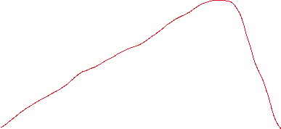
If $f\left(d\right)>f(c)$
$$a$$
$$c$$
$$d$$
$$b$$

Slide 4
If $f\left(d\right)>f(c)$
$$a$$
$$c$$
$$d$$
$$b$$

Slide 5

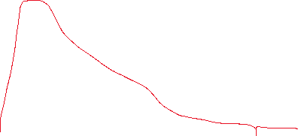
If $f\left(d\right)<f(c)$
$$a$$
$$c$$
$$d$$
$$b$$

Slide 6
If $f\left(d\right)<f(c)$
$$a$$
$$c$$
$$d$$
$$b$$

Slide 7














$$d_{2}$$
$$d_{1}$$
$$d_{3}$$
Rules:
1. $\left|\overline{ac}\right|=$ $\left|bd\right|. → d_{1}=d_{2}−d_{3}$
2. spacing after evaluation is proportional to the spacing prior to that evaluation
$$\frac{d_{1}}{d_{2}}=\frac{d_{3}}{d_{2}−d_{3}}$$
$$\frac{d_{1}}{d_{2}}=\frac{d_{3}}{d_{1}}$$
$$a$$
$$c$$
$$d$$
$$b$$
Conclusion
$${\left(\frac{d_{2}}{d_{1}}\right)}^{2}−\left(\frac{d_{2}}{d_{1}}\right)=1$$
$$φ= \left(\frac{d_{2}}{d_{1}}\right)=\frac{1+\sqrt{5}}{2 }≅1.618$$
Corollary
$${\left(\frac{d_{2}}{d_{1}}\right)}^{2}−\left(\frac{d_{2}}{d_{1}}\right)=1$$
$$φ= \left(\frac{d_{2}}{d_{1}}\right)=\frac{1+\sqrt{5}}{2 }≅1.618$$
$$a$$
$$c$$
$$d$$
$$b$$

Slide 8
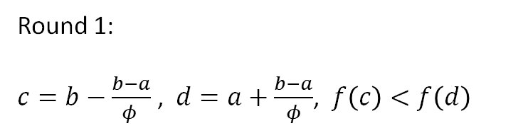
Round 1:
$c=b−\frac{b−a}{φ }$ , $d=a+\frac{b−a}{φ}$, $f\left(c\right)<f\left(d\right)$
$$a$$
$$c$$
$$d$$
$$b$$

Slide 9
Round 1:
$c=b−\frac{b−a}{φ }$ , $d=a+\frac{b−a}{φ}$, $f\left(c\right)<f\left(d\right)$
$$a$$
$$b$$

Slide 10

Round 1:
$c=b−\frac{b−a}{φ }$ , $d=a+\frac{b−a}{φ}$, $f\left(c\right)<f\left(d\right)$
Round 2:
$$f\left(c\right)<f\left(d\right)$$
$$a$$
$$c$$
$$d$$
$$b$$

Slide 11
Round 1:
$c=b−\frac{b−a}{φ }$ , $d=a+\frac{b−a}{φ}$, $f\left(c\right)<f\left(d\right)$
Round 2:
$$f\left(c\right)<f\left(d\right)$$
$$a$$
$$b$$

Slide 12


Round 1:
$c=b−\frac{b−a}{φ }$ , $d=a+\frac{b−a}{φ}$, $f\left(c\right)<f\left(d\right)$
Round 2:
$$f\left(c\right)<f\left(d\right)$$
Round 3:
$$f\left(c\right)>f\left(d\right)$$
$$a$$
$$c$$
$$d$$
$$b$$

Slide 13
Round 1:
$c=b−\frac{b−a}{φ }$ , $d=a+\frac{b−a}{φ}$, $f\left(c\right)<f\left(d\right)$
Round 2:
$$f\left(c\right)<f\left(d\right)$$
Round 3:
$$f\left(c\right)>f\left(d\right)$$
$$a$$
$$c$$
$$d$$
$$b$$

Slide 14
Round 1:
$c=b−\frac{b−a}{φ }$ , $d=a+\frac{b−a}{φ}$, $f\left(c\right)<f\left(d\right)$
Round 2:
$$f\left(c\right)<f\left(d\right)$$
Round 3:
$$f\left(c\right)>f\left(d\right)$$
$$a$$
$$c$$
$$d$$
$$b$$

Slide 15
Round 1:
$c=b−\frac{b−a}{φ }$ , $d=a+\frac{b−a}{φ}$, $f\left(c\right)<f\left(d\right)$
Round 2:
$$f\left(c\right)<f\left(d\right)$$
Round 3:
$$f\left(c\right)>f\left(d\right)$$
$$a$$
$$b$$

Slide 16
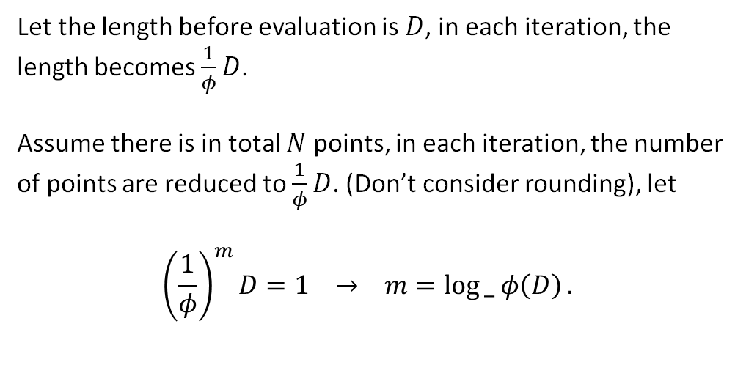
Let the length before evaluation is $D$, in each iteration, the length becomes $\frac{1}{φ}D$.
Assume there is in total $N$ points, in each iteration, the number of points are reduced to $\frac{1}{φ}D$. (Don’t consider rounding), let
$${\left(\frac{1}{φ}\right)}^{m}D=1 → m=\log{_ φ\left(D\right)}.$$
$$a$$
$$c$$
$$d$$
$$b$$

